Slide 1
Seated asanas
YIN: relaxing, targeting fascia, ligaments, and tendons

Slide 2
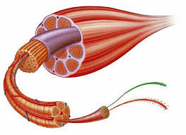
Fascia—encases muscle tissue and promotes smooth muscle contraction.

Slide 3
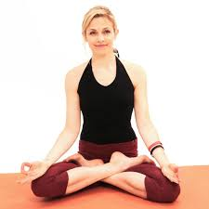
Comfortable seat--sukasana

Slide 4
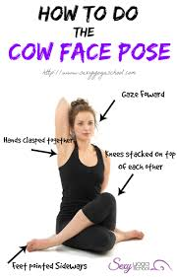
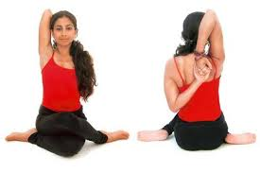
Cow face-- gomukhasana

Slide 5
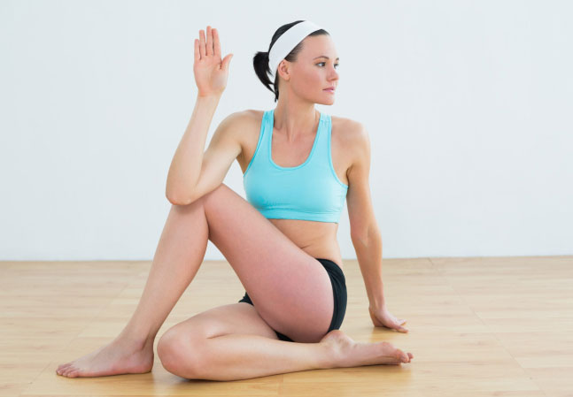
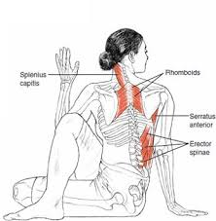
Seated half-fish,(half lord of fishes)ardha matsyendrasana

Slide 6
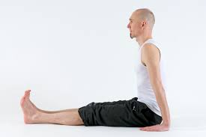
Staff--Dandasana

Slide 7
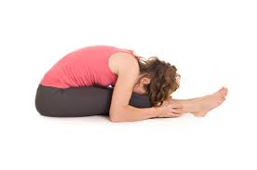
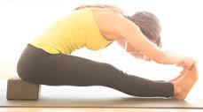
Seated forward fold--Paschimottanasana

Slide 8
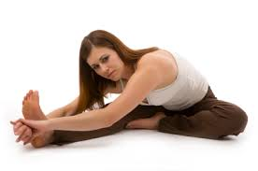
Seated head to knee—janu sirsasana

Slide 9
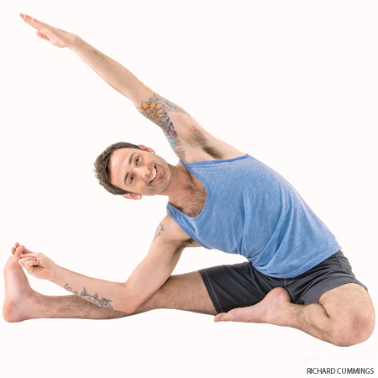
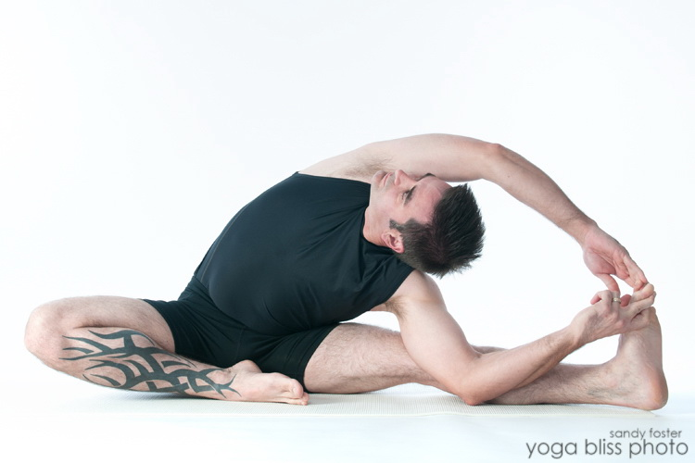
Revolved head to knee—parivrtta janu sirasana

Slide 10
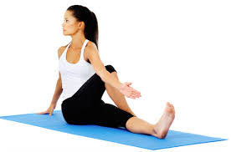
Seated twist--marichyasana

Slide 11
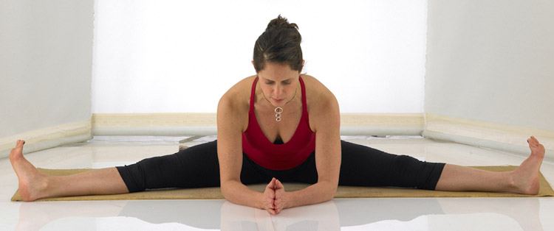
Wide-angle seated forward fold –upavistha konasana

Slide 12
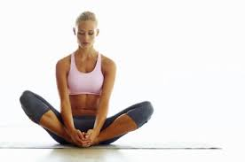
Bound angle—baddha konasana

Slide 13
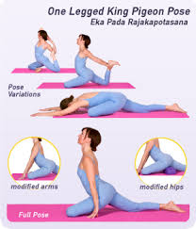
Single pigeon--

Slide 14
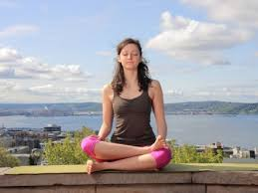
Double pigeon

Slide 15
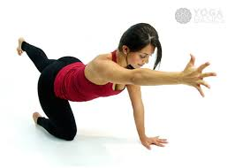
birdog

Slide 16
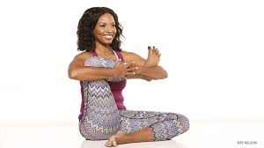
Seated leg cradle

Slide 17
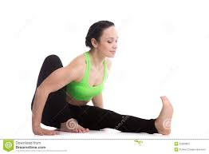
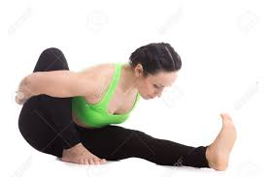
Sage forward fold

Slide 18
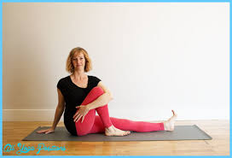
Sage twist

Slide 19
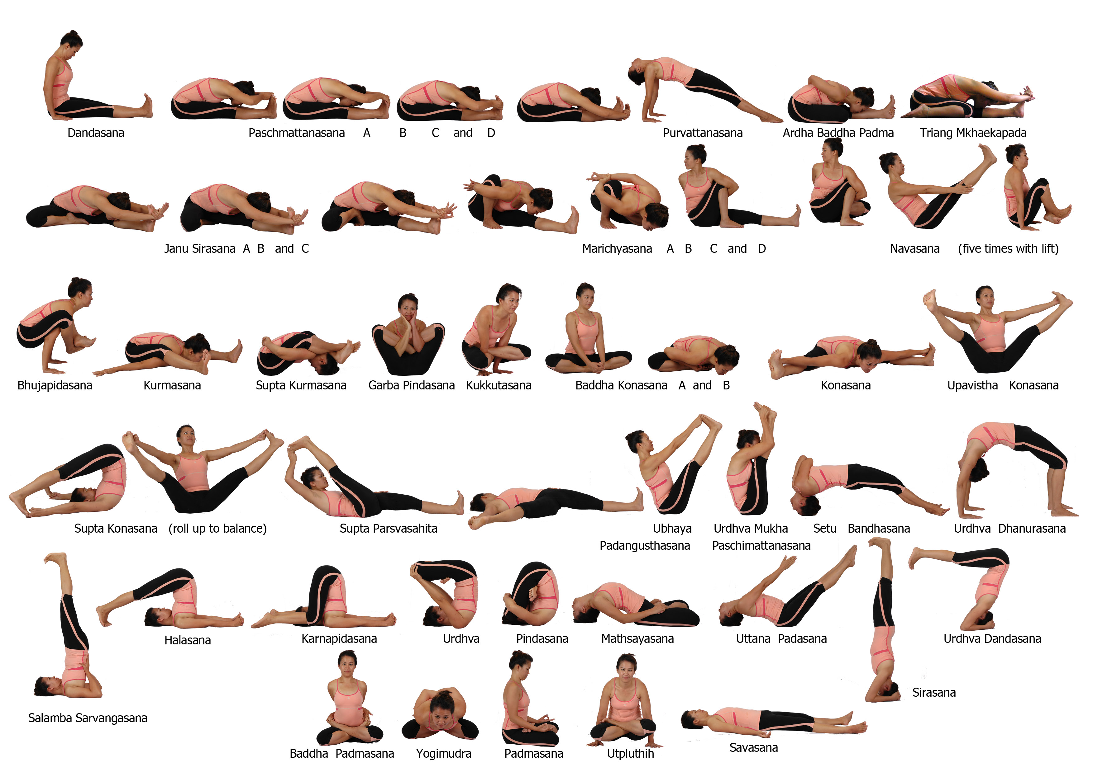

Slide 20
